Slide 1

ME 203 Introduction to MATLAB
‹#›

Slide 2
MATLAB ???
It is an acronym
MATLAB = Matrix Laboratory
MATLAB An Advanced Computation & Programming Software for ENGINEERS

Slide 3
Introduction
First release in 1984
Technical Computing
Numerical computing environment
Allows
matrix manipulation,
plotting of functions and data,
implementation of algorithms,
creation of user interfaces,
interfacing with programs in other languages, and
data visualization.

Slide 4
Introduction
It can be used as
Simple calculator
Scientific calculator
Simple programming language (it is based on C and C++)
You can write your own
scripts
functions

Slide 5
Running MATLAB
Computer with Matlab installed
Double-click on the Matlab icon or select Matlab from Start/Programs
Computer without Matlab installed
Go to https://remote.unr.edu/
Use your UNR NetID to log in

Slide 6
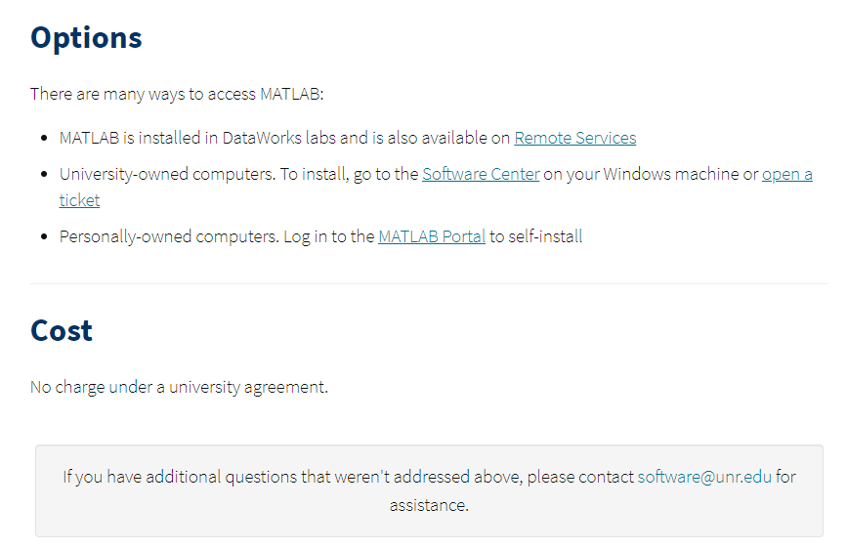
Running MATLAB
https://oit.unr.edu/services-and-support/software-and-online-applications/software-list/matlab/

Slide 7
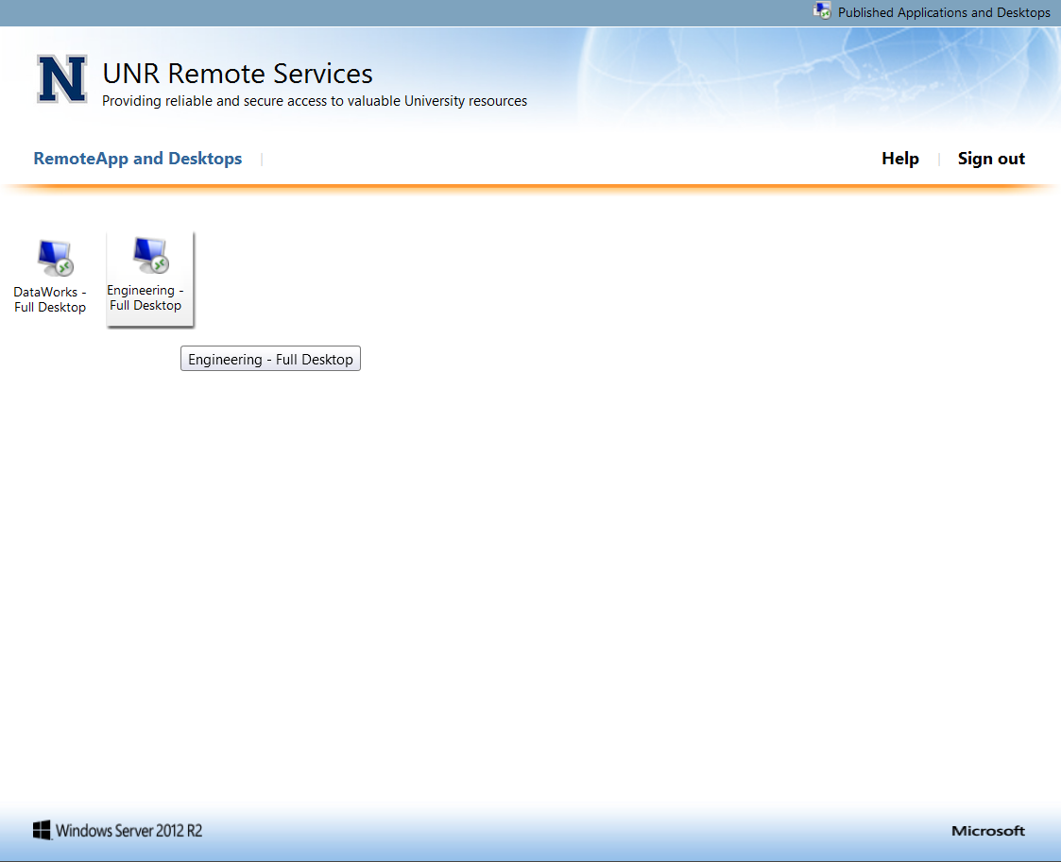
UNR Remote Services

Slide 8
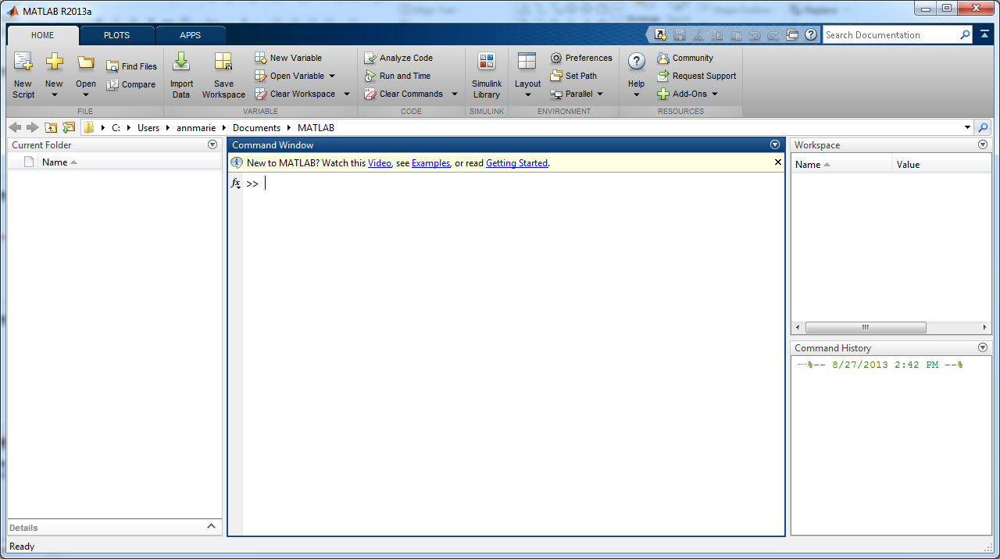
Screenshot
Current folder path
Workspace Window provides info about the variables being used
Command Window is where you enter variables and run programs
Current Folder shows files in the current directory
Command History Window logs the commands entered

Slide 9
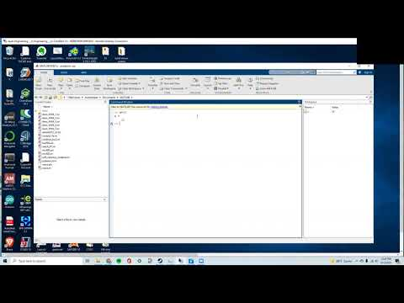
https://youtu.be/bOwjPQMdxzA

Slide 10
Matlab operations
You can perform operations in Matlab in 2 ways
Command Window-runs in an interactive mode (commands are entered directly)
Run a program stored in a Script file
ALWAYS use Script files for ALL assignments!
Notes:
What is the difference between a script file and function file? Scripts run on their own. Functions take an input from the user each time it runs making it more powerful. Functions provide output for other scripts to use.

Slide 11
Script File (M File)
Script files contain Matlab commands so running a script is equivalent to typing all the commands
Runs on its own!
Can be saved and reused
May include any valid Matlab commands or functions
Will save you from retyping common procedures
Script files are also know as M files because they are saved as
Name.m
File names must follow the same rules as variable names
Notes:
What is the difference between a script file and function file? Scripts run on their own. Functions take an input from the user each time it runs making it more powerful. Functions provide output for other scripts to use.

Slide 12
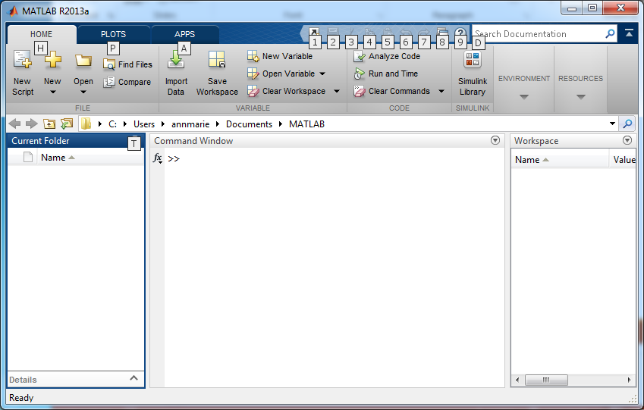
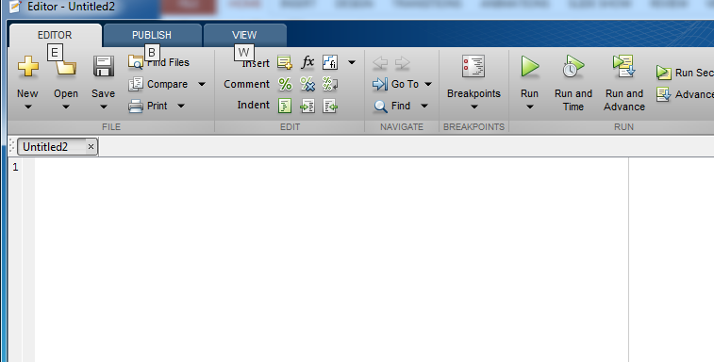
Creating a Script File
1. Click here to create a script
3. Click here to save
2. Type your program here!
Notes:
Creating a new program. Click new script

Slide 13
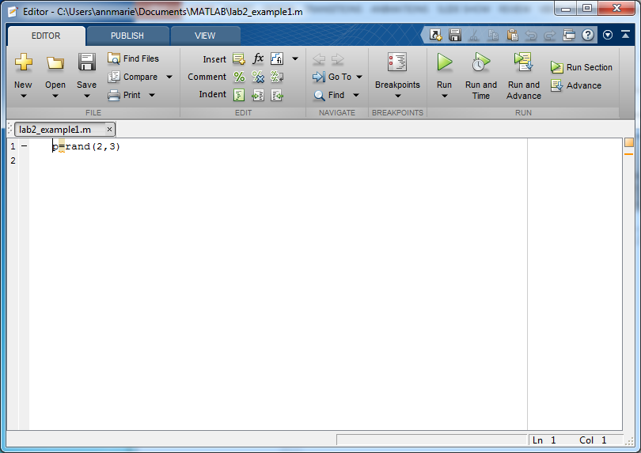
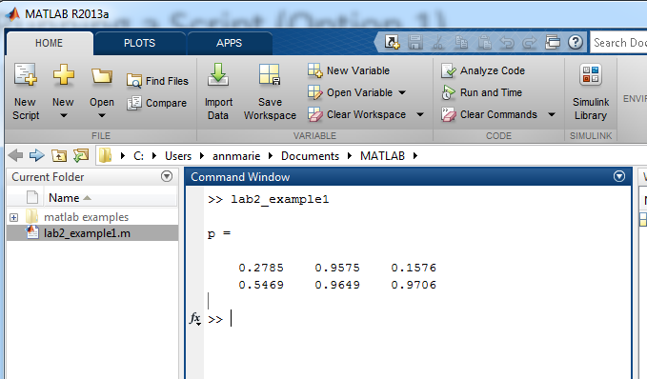
Running a Script (Option 1)
Click on Run in the Script Window

Slide 14
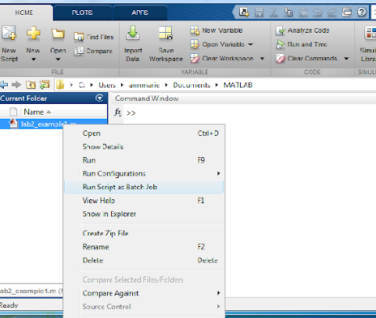
Running a Script (Option 2)
Right click on the file and select Run or press F9

Slide 15
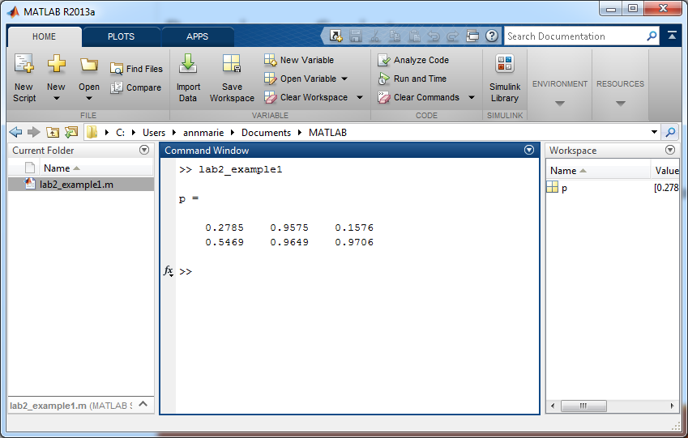
Running a Script (Option 3)
Type the Script name into the Command Window
*Useful when your script is a function and you need to provide inputs

Slide 16
Variables and Assignment Statements
Rules for variable names :
• Must start with a letter
• May consist only of the letters a-z, digits 0-9, and the underscore character (_)
• May be as long as you would like, but Matlab only recognizes the first 31 characters
• Is case sensitive: items, Items, itEms, and ITEMS are all different variable names.
• A variable cannot be used in a statement until it is defined

Slide 17
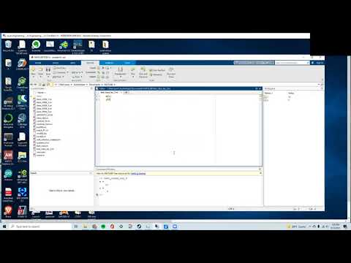
https://youtu.be/zzDxesZw3y4

Slide 18
Getting Help
• help – On-line help, display text at command line
help, by itself, lists all help topics
help topic provides help for the specified topic
help command provides help for the specified command
help help provides information on use of the help command
• helpwin – On-line help, separate window for navigation.
• DOC – Comprehensive hypertext documentation and troubleshooting
• demo – Run demonstrations
• lookfor – search for functions on the basis of a keyword

Slide 19
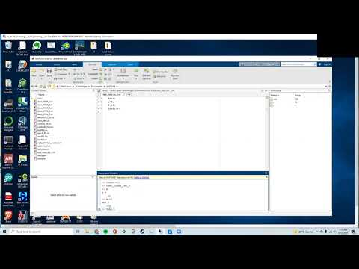
https://youtu.be/sCP24d5F-_g

Slide 20
Interrupting and Terminating Matlab
Ctrl-C (pressing the Ctrl and c keys simultaneously): Interrupts (aborts) processing, but does not terminate Matlab. You may want to interrupt Matlab if you mistakenly command it to display thousands of results and you wish to stop the time-consuming display.
quit: Terminates Matlab
exit: Terminates Matlab
Click the close button : Terminates Matlab

Slide 21
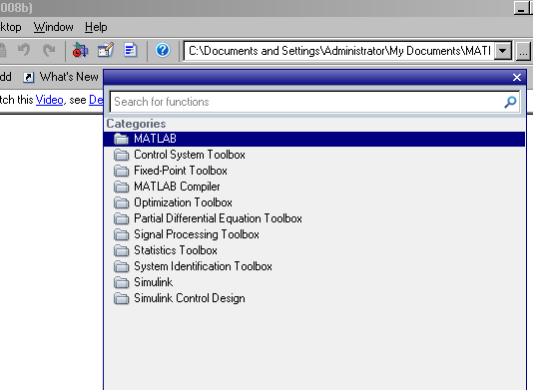
Function Browser
Function browser (shift F1)
Click on MATLAB in the dialog box

Slide 22
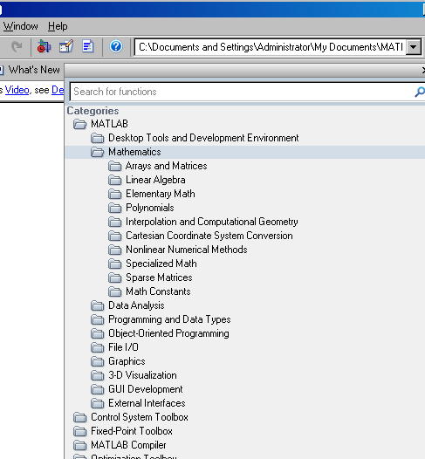
Function Browser
Click on Mathematics to see the functions under different topics

Slide 23
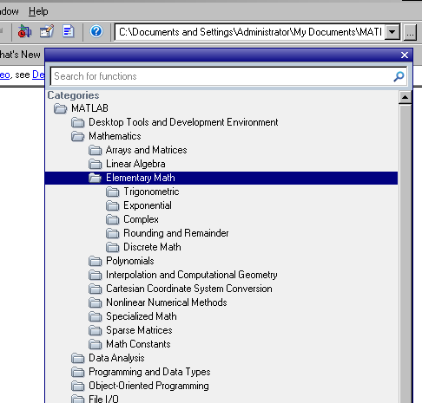
Function Browser
Click the titles to see the functions inside. For example let’s check “Elementary Math”

Slide 24
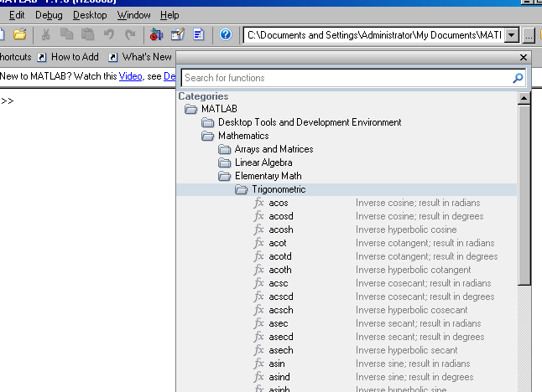
Function Browser
Let’s see the “Trigonometric”
Well, MATLAB is a huge software with thousands of functions!

Slide 25
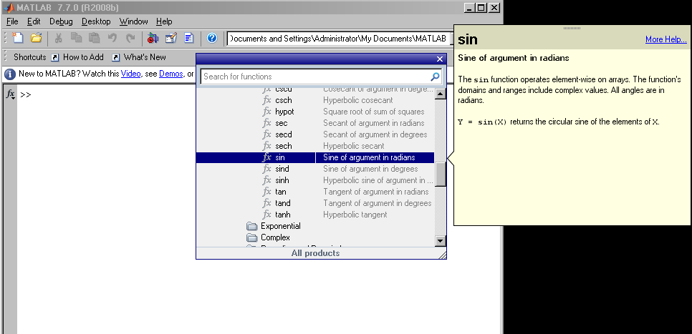
Function Browser
Let’s find the “sin” function and click on it

Slide 26
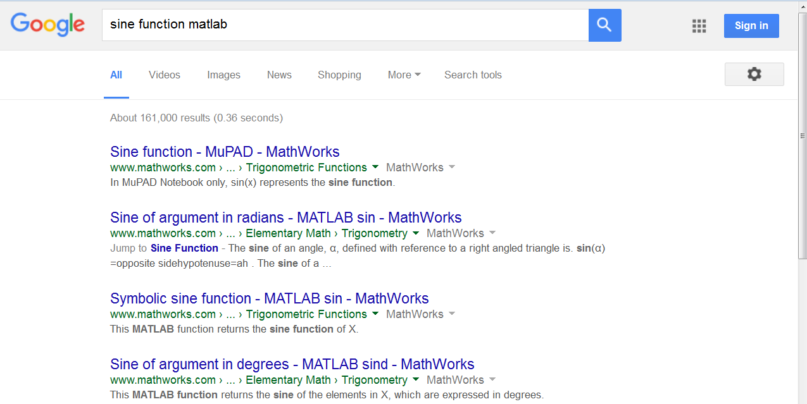
Online Help
OR just Google the function you need: Since MATLAB is widely used in the world, you will probably find it!

Slide 27
Clear and Format
The clc command
Clears the command window
The clear command
Clears the workspace
clear all clears all variables in the workspace
Example if you type: clear var1 only var1 would be erased
The format command
Allows you to specify the number format and the display in the command window
Example if you type: format compact Matlab won’t skip a line when displaying results
Example if you type: format LONGENG the number displayed will have exactly 16 significant digits and a power that is a multiple of three.

Slide 28
Other useful things…
F5 runs program
Use 🡩 🡫keys to scroll through previously entered commands and rerun.
Arrow up and press enter
who: lists the names of defined variables
whos: lists the names and sizes of defined variables
close all: closes all plot windows
clf: clears the current figure and thus clears the graph window

Slide 29
Scalar Mathematics
A scalar is a single number without direction
Operation Algebraic form Matlab Example
Addition a + b a + b 5 +3
Subtraction a − b a - b 23-12
Multiplication a × b a * b 3.14*0.85
Right division a ÷ b a / b 56/8
Left division b ÷ a a \ b 8\56
Exponentiation a^{b} a ^ b 5 ^2

Slide 30
Scalar Mathematics
Order of Operations (or use of parenthesis) is important
Examples
6*5-5
=25
6*(5-5)
=0
Precedence | Math Function
First | Parenthesis
Second | Exponentiation
Third | Multiplication and Division
Fourth | Addition and Subtraction

Slide 31
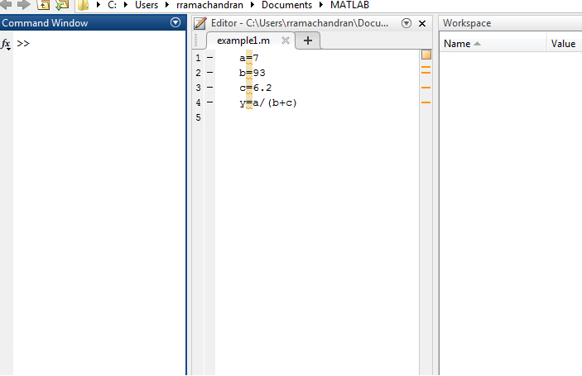
Example: Defining Variables
Calculate y given y=a/(b+c) where a=7, b=93 and c=6.2

Slide 32
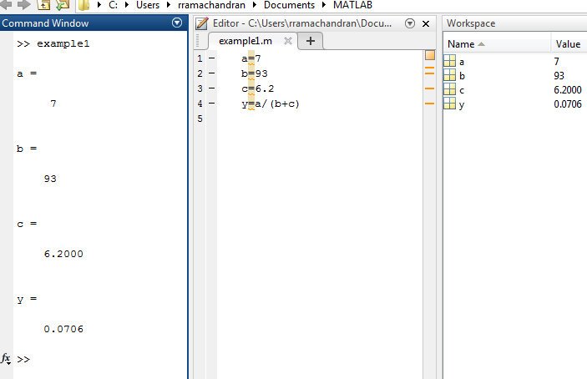
Example: Defining Variables
Calculate y given y=a/(b+c) where a=7, b=93 and c=6.2

Slide 33
Comments
Percentage Sign (%)
When the % symbol is typed at the beginning of a line, the line is considered a comment
Comment lines are not executed
Example: All HW code should start with your name
% Ashish Kasar
% ME 203, Section 1101
% Lab 4
You can comment or uncomment multiple lines by highlighting them and using the following commands
Ctrl R comments the line
Ctrl T uncomments the line

Slide 34
Punctuation
Semicolons (;)
Type at the end of the command when you do not want to see the output
Can be useful when you don’t want to see all the small steps
Commas and semicolons can be used to place multiple commands on one line
commas display the results
semicolons suppress the results
Three periods (. . .) at the end of a command indicates that the command continues on the next line. A continuation cannot be given in the middle of a variable name.

Slide 35
Code Structure
Problem description
Format workspace
Given information
Preliminary Calculations (If needed)
Initialize variables (If needed)
Calculations
Display Answer (This may be done in the calculations)

Slide 36
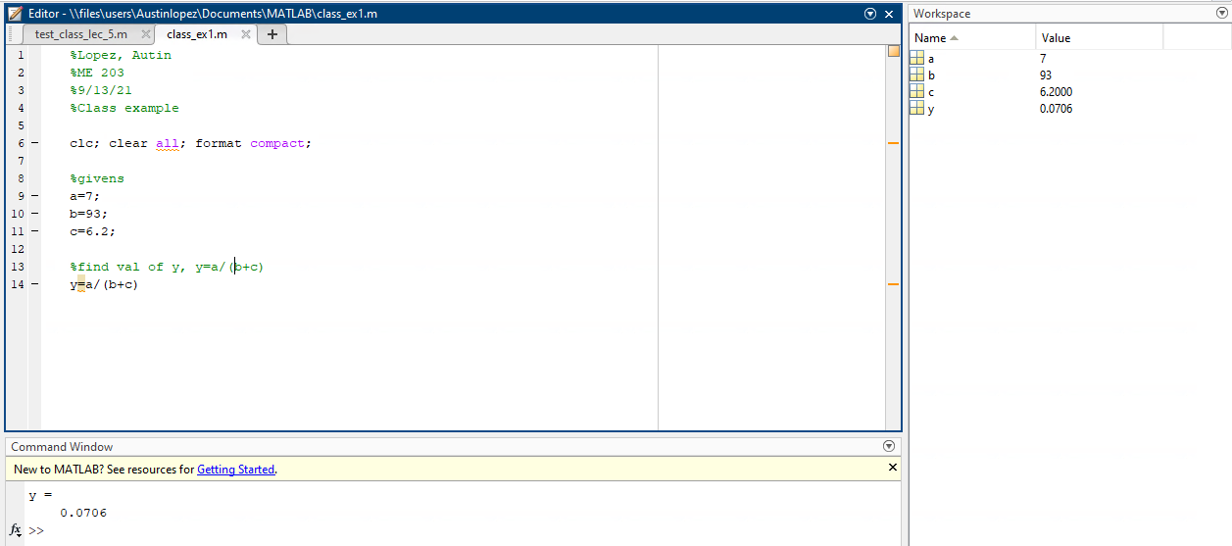
Example: Defining Variables
Calculate y given y=a/(b+c) where a=7, b=93 and c=6.2

Slide 37
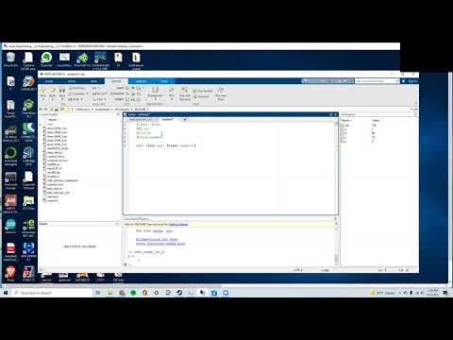
https://youtu.be/3hb6Gu8RYQ4

